Slide 1
ResponsibleML based models for prioritizing liver-transplant candidates in the US
Machine Learning Workshop
August 26, 2021
Hoang Thien Ly

Slide 2
Outline
1/ Transplant problem and sickest-first policy
2/ MELD-Score and optimistic results
3/ Applying ML Techniques
- Process of cleaning datasets
- Models and obtained results from a paper
4/ Related works and Q&A section

Slide 3




Transplant problem & policy
I am patient with end-stage
liver disease. I need a liver-transplantation.

Slide 4






- One national waiting list for the entire US. You can register at medical centers in different regions.
Waiting time cannot be predictable and may vary from regions of the country and from the illness levels.
I am patient with end-stage
liver disease. I need a liver-tranplanatation.

Slide 5
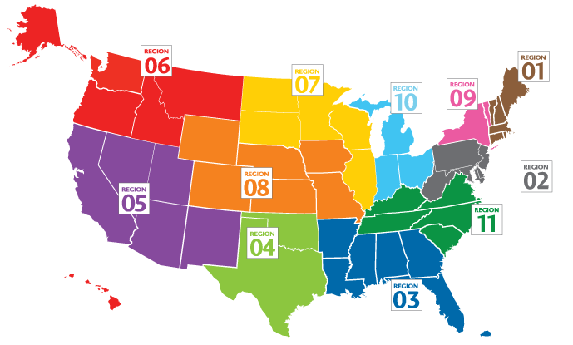
UNOS.org (United Network for Organ Sharing)

Slide 6


The deceased donor livers are assigned to matches among patients according to sickest-first policy.
When get top of the waiting list, we consider compatibility of patient to donor liver to lower risk of failure:
+ Blood type,
+ Body size,
+ Geographical considerations…
I am patient with end-stage
liver disease. I need a liver-tranplanatation.

Slide 7
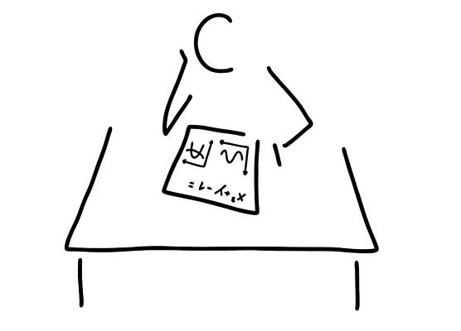


November 12, 2019:
12 965 patients are on waiting list for liver transplantation.
In 2018:
12 700 patients were added to the list.
8 250 liver transplants were performed.
609 patients died while waiting.
627 patients were removed due to being too sick.
I am patient with end-stage
liver disease. I need a liver-tranplanatation.

Slide 8
Problem of assessing disease severity of a patient

Slide 9
Outline
1/ Transplant problem and sickest-first policy
2/ MELD-Score and optimistic results
3/ Applying ML Techniques
- Process of cleaning datasets
- Models and obtained results from a paper
4/ Related works and Q&A section

Slide 10
MELD-score and its variants
The Model for End-stage Liver Disease (MELD-score) estimates the chance of surviving during the next 3 months of patients with chronic liver disease.
MELD-score is ranged from 6 to over 40
The higher the score, the sicker the patient is, and the higher his/her position is in waiting list
It has variants: MELD, MELD-Na, MELD-exception (for liver cancer, or hepatopulmonary syndrome,…) and PELD (for pediatric patients)

Slide 11
MELD-score and its variants
1 Year Survival Rate Based on MELD Scores
MELD Score | Waiting list | Post Transplant
Score 10 | 90% survival | 83% survival
Score 15 | 81% survival | 80% survival
Score 20 | 63% survival | 78% survival
Score 25 | 42% survival | 74% survival
Score 30 | 21% survival | 71% survival
Calculating the MELD Score [UndergroundMed]

Slide 12
Formula of MELD-Score
MELD = 3.78 × ln [Bili (mg/dL)] + 11.2 × ln [INR] +
+9.57 × ln [Creati (mg/dL)] + 6.43
MELD-Na=MELD + 1.32 x (137 - Na) - [0.033 x MELD*(137 - Na)]
Bilirubin: how well liver clears substance “bile” (żółć) )
INR: how well liver makes proteins needed for blood to clot (krzepnięcie krwi)
Creatinine: how well kidneys work
Na: serum sodium, recently added, how well body regulates fluid balance.
Ranged from 125 to 137

Slide 13
Optimistic results from MELD-Score
The MELD-based allocation system was immediately successful, leading to the first ever reduction in the number of waiting list candidates and a 15% reduction in mortality among those on the waiting list.
Freeman, R., Wiesner, R., Edwards, E., Harper, A., Merion, R., Wolfe, R.: Results of the first year of the new liver allocation plan. Liver Transplant, 10, 7-15 (2004)

Slide 14
Drawbacks of MELD-Score based system
The log-transformed values of Bili, INR, Creati at 1.0 can be problematic, as a large percentage waiting list candidates possess Creati levels below, and values below this threshold can reflect different levels of kidney function.
Correlation between MELD and outcome is not equally strong for all patients. For some patients, MELD may not accurately reflect the severity of their condition.
Sharma, P., Schaubel, D., Sima, C., Merion, R., Merion, R., Lok, A.: Re-weighting the model for end-stage liver disease score components. Gastroenterology, 135, 1574-1581 (2008)

Slide 15
It’s high time for ML Models!!

Slide 16
Outline
1/ Transplant problem and sickest-first policy
2/ MELD-Score and optimistic results
3/ Applying ML Techniques
- Process of cleaning datasets
- Models and obtained results from a paper
4/ Related works and Q&A section

Slide 17
Applying ML methods
Data: waiting list histories from January 1, 2002 to September 5, 2021
Data division: 60-40% for train-test
Out of sample test set.
Metric: ROC AUC (concerning with giving livers to patients who most need them than accurately predicting mortality risk)
Number of features: 426, ~330 000 observations
Some known at registration
Some updated over time

Slide 18
Data Preprocessing
Remove columns having > 30% NAs
Num features with NAs ← median
Cat features ← dummy variables
Data is quite balanced.
Train models using two different feature sets:
First set: non demographic features: Bilirubin, INR, Creatinine, Albumin, Sodium and several lab-based dialysis in previous weeks
Second set: first set including Bmi_Calc and Gender.

Slide 19



Training model
Models: randomForest, catboost, XGBoost & LightGBM by {forester}
Detail at: https://github.com/ModelOriented/forester
XAI methods: https://github.com/ModelOriented/modelStudio
Checking fairness: https://github.com/ModelOriented/fairmodels

Slide 20
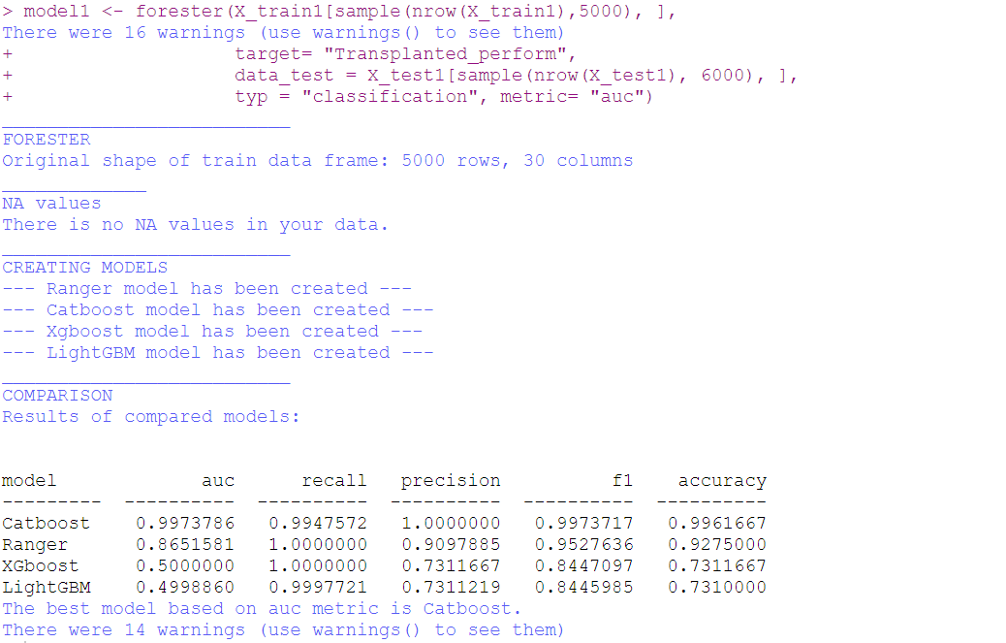
Obtained results

Slide 21
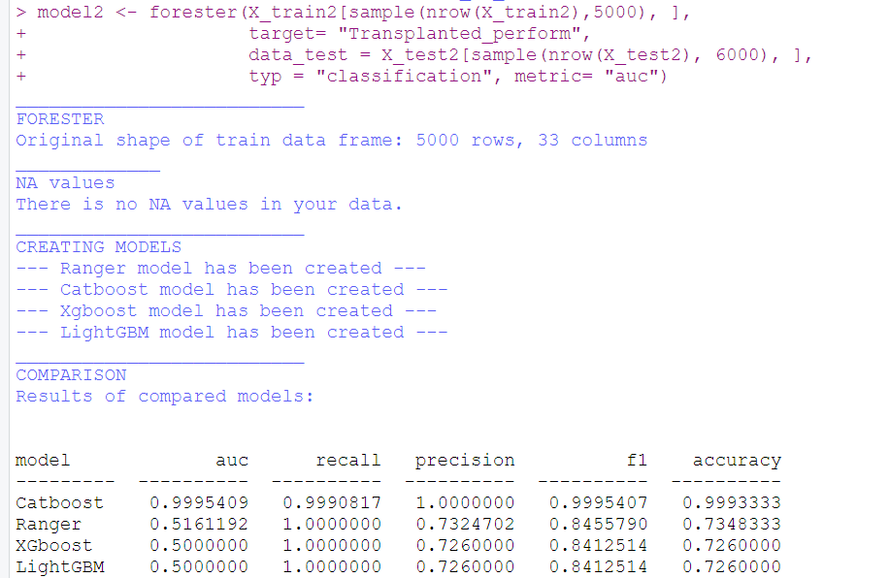
Obtained results

Slide 22
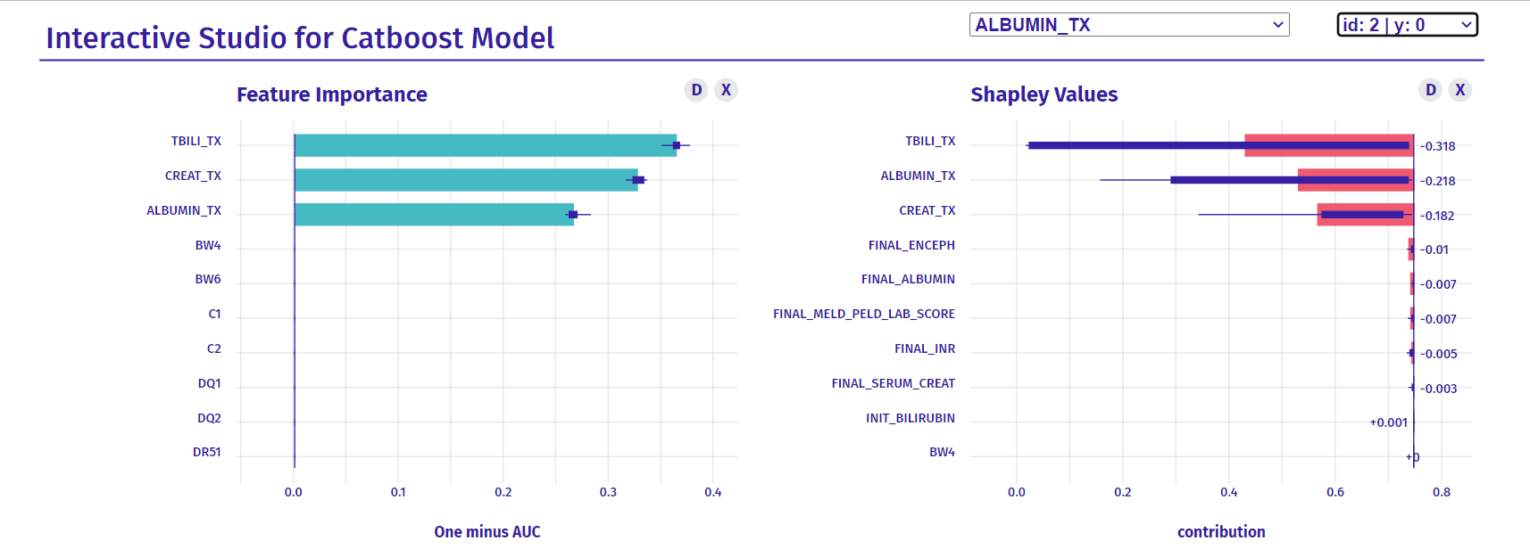
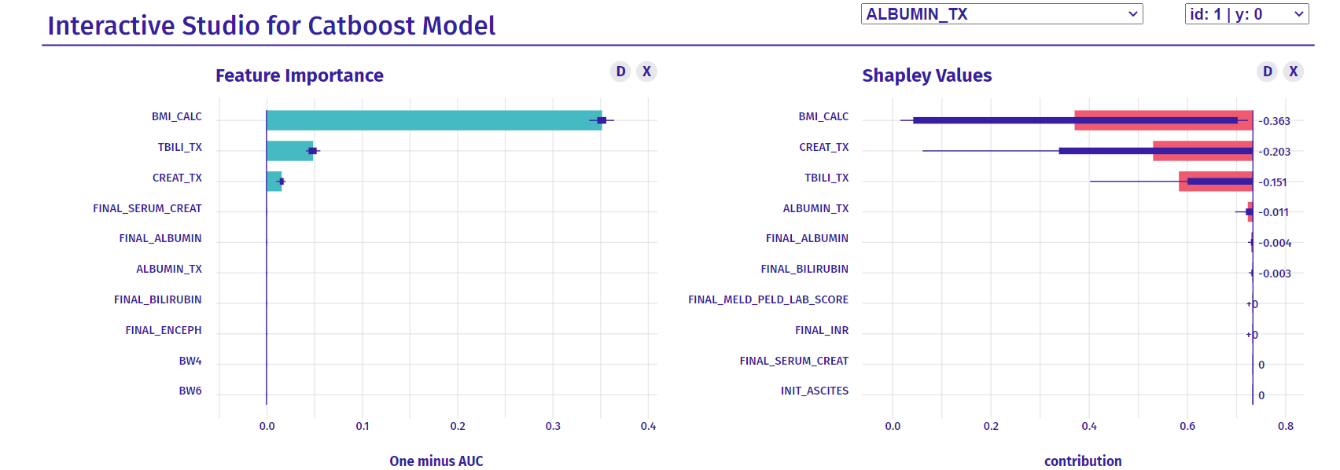

Slide 23
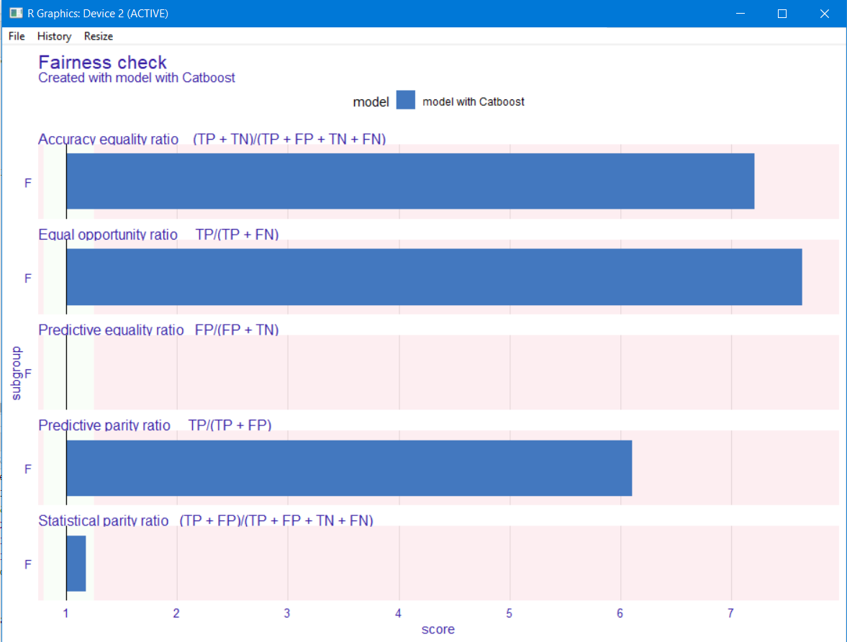
Fairness check

Slide 24
Conclusions
Model returns almost perfect score for AUC (catboost)
Removing demographic features (BMI-Calc, gender,…) and subjective features does not have a large effect on model performance
Based on pertubation-important variables, we propose to add Albumin & BMI into MELD-Score model!
Our model is unfair in respect to Gender, more biased to male.

Slide 25
References
Predicting Mortality in Liver Transplant Candidates Explainable AI in Healthcare and Medicine, 2021, Volume 914 ISBN : 978-3-030-53351-9 Jonathon Byrd, Sivaraman Balakrishnan, Xiaoqian Jiang, Zachary C. Lipton
Mathematical
Liver Transplant Waitlist, Part 1 | UCLA Transplantation Services
https://columbiasurgery.org/liver/liver-transplant-waiting-list
https://www.ncbi.nlm.nih.gov/pmc/articles/PMC6902892/#:~:text=MELD%2DNa%20was%20calculated%20through,United%20Network%20for%20Organ%20Sharing)
https://www.organdonor.gov/learn/organ-donation-statistics
UNOS.org

Slide 26
Outline
1/ Transplant problem and sickest-first policy
2/ MELD-Score and optimistic results
3/ Applying ML Techniques
- Process of cleaning datasets
- Models and obtained results from a paper
4/ Related works and Q&A section

Slide 27
Discussion Time

